Slide 1

BUILDING SECURITY SYSTEM USING ULTRASONIC SESNOR, FLAME & PIR SENSOR
Course Title: Sensing and Sensor Technology
Nooruddin : 6218000081
Rahul : 6217000181
Jannatun Ferdous : 6218000014

Slide 2
Outlines
Motivation
Detection module
Warning module
Light module
Fire alarm module
Components and Languages
Implementation

Slide 3
Motivation
Security has always been a major concern for all of us.
there are many Hi tech and IoT based security and surveillance system are available in the market.
We were inspired to build an ultrasonic security system for our project by building security system. Security is very import part of building

Slide 4
Detection module
The system is capable of detecting intruders of the time, provided that sensor was placed at appropriate position.
The few times that intruder get away are when they are capable of crossing past the sensor quicker

Slide 5
Warning module
In this module passive infrared sensor (PIR) is used to detect something when the human body can touch them.
The PIR sensor is used to collect signals and then it can alarm when the body touch it.

Slide 6
Light module
Turn on the lights or the lighting of the system and any type of alert occur from any sensor it may alarm and lightened.
This can occur in any crucial time and it can be understood by led light and by their alarm

Slide 7
Fire alarm module
A flame alarm is used to simulate the fire alarm.
Once there is fire, the buzzer and LED alarms are immediately penalized.

Slide 8
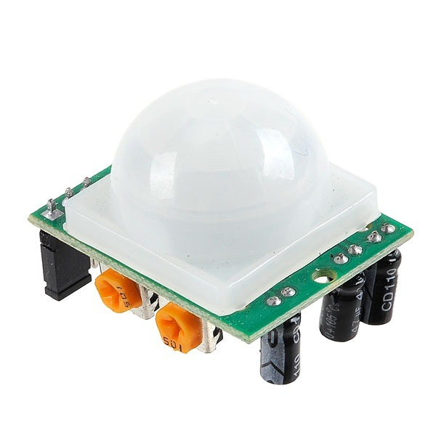
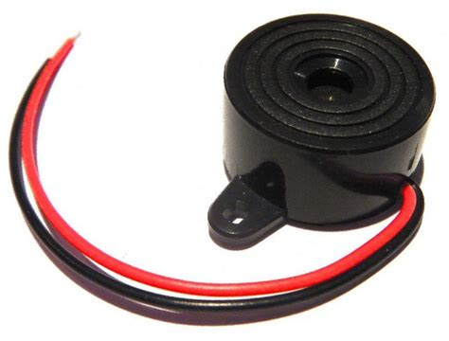
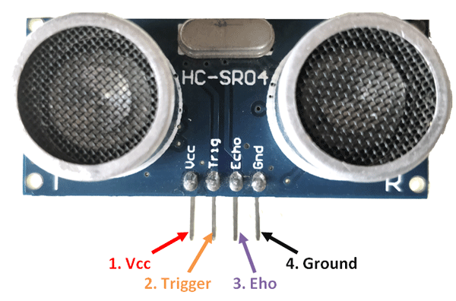
Components and Languages
Components:
Ultrasonic Sensor
Passive Infrared Sensor(PIR)
LED
Buzzer
Light module
Arduino nano kit
Bread Board
Languages:
C# and VS 15
Arduino 1.8.7
Passive Infrared Sensor
Buzzer
Ultrasonic Sensor

Slide 9
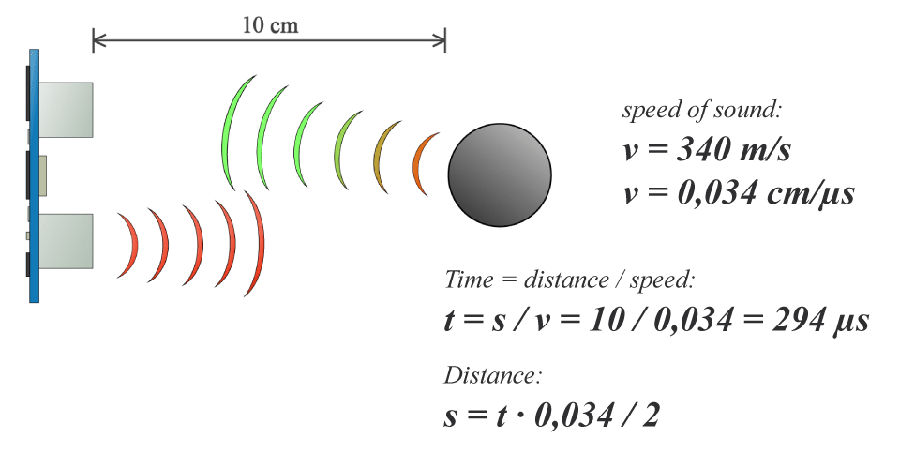
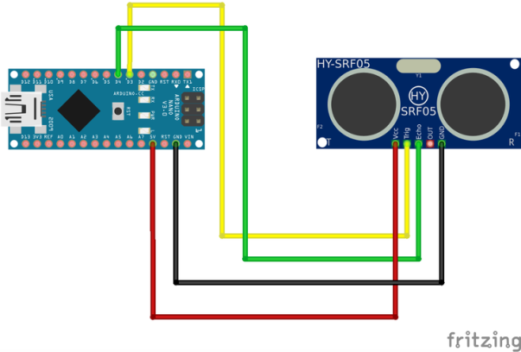
Implementation
Distance Measure using Ultrasonic Sensor
Considering the travel time and the speed of the sound the distance can be calculated.
To generate the ultrasound it need to set the Trig on a High State for 10 µs
That will send out an 8 cycle sonic burst which will travel at the speed sound and it will be received in the Echo pin

Slide 10
Implementation
FIRE Alarm Using Flame Sensor
"VCC" pin of the sensor to 5V of arduino.
"GND" ground pin to GND of arduino.
"AO" analog output pin to any analog
or digital pins on the arduino.
Longer LED leg to pin 13 on the arduino.
Shorter LED leg to GND pin on the arduino.
Fix buzzer on the breadboard.
Longer buzzer leg to pin 11 on the arduino.
Shorter buzzer leg to GND pin on the arduino.
Image of Circuit

Slide 11
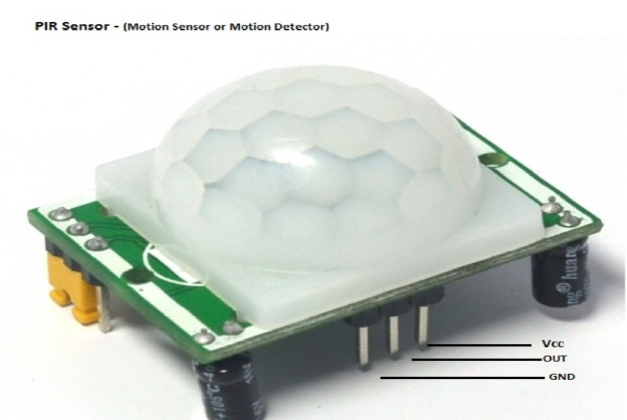
Implementation
Motion Sensing Using PIR:
PIR:
Ground, VCC and output (gives high logic level if an object is detected)
two potentiometers(for adjusting
the sensitivity of the sensor and
Adjusting the time the output signal stays high
when object is detected)

Slide 12
Implementation
Distance Measure using Ultrasonic Sensor
Considering the travel time and the speed of the sound the distance can be calculated.
To generate the ultrasound it need to set the Trig on a High State for 10 µs
That will send out an 8 cycle sonic burst which will travel at the speed sound and it will be received in the Echo pin

Slide 13
Implementation
FIRE Alarm Using Flame Sensor
"VCC" pin of the sensor to 5V of arduino.
"GND" ground pin to GND of arduino.
"AO" analog output pin to any analog
or digital pins on the arduino.
Longer LED leg to pin 13 on the arduino.
Shorter LED leg to GND pin on the arduino.
Fix buzzer on the breadboard.
Longer buzzer leg to pin 11 on the arduino.
Shorter buzzer leg to GND pin on the arduino.
Image of Circuit

Slide 14
Implementation
Motion Sensing Using PIR:
PIR:
Ground, VCC and output (gives high logic level if an object is detected)
two potentiometers(for adjusting
the sensitivity of the sensor and
Adjusting the time the output signal stays high
when object is detected)

Slide 15
Implementation
Final Complete Project Code:

Slide 16
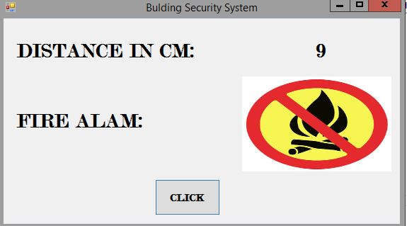
Implementation
Output

Slide 17
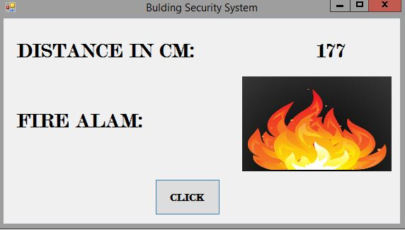
Implementation
Output

Slide 18
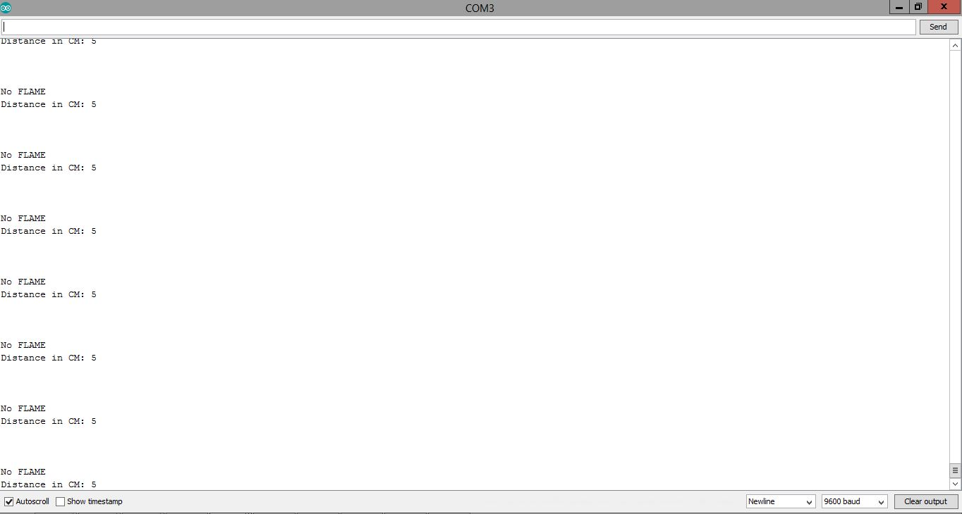
Implementation
Output

Slide 19
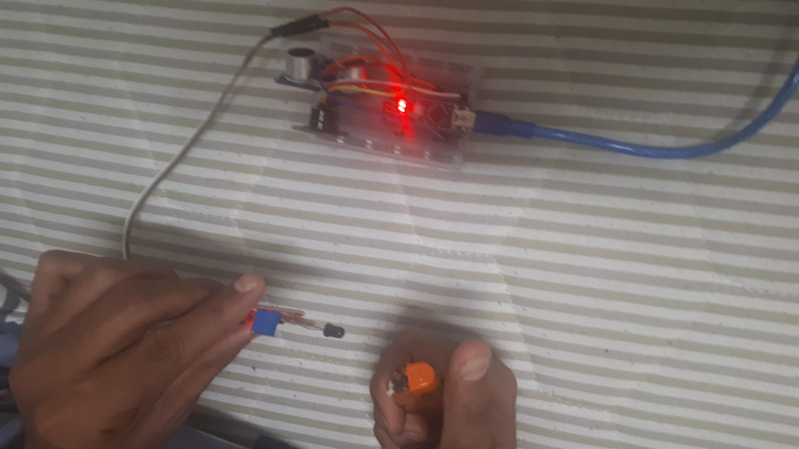
Implementation
Output

Slide 20
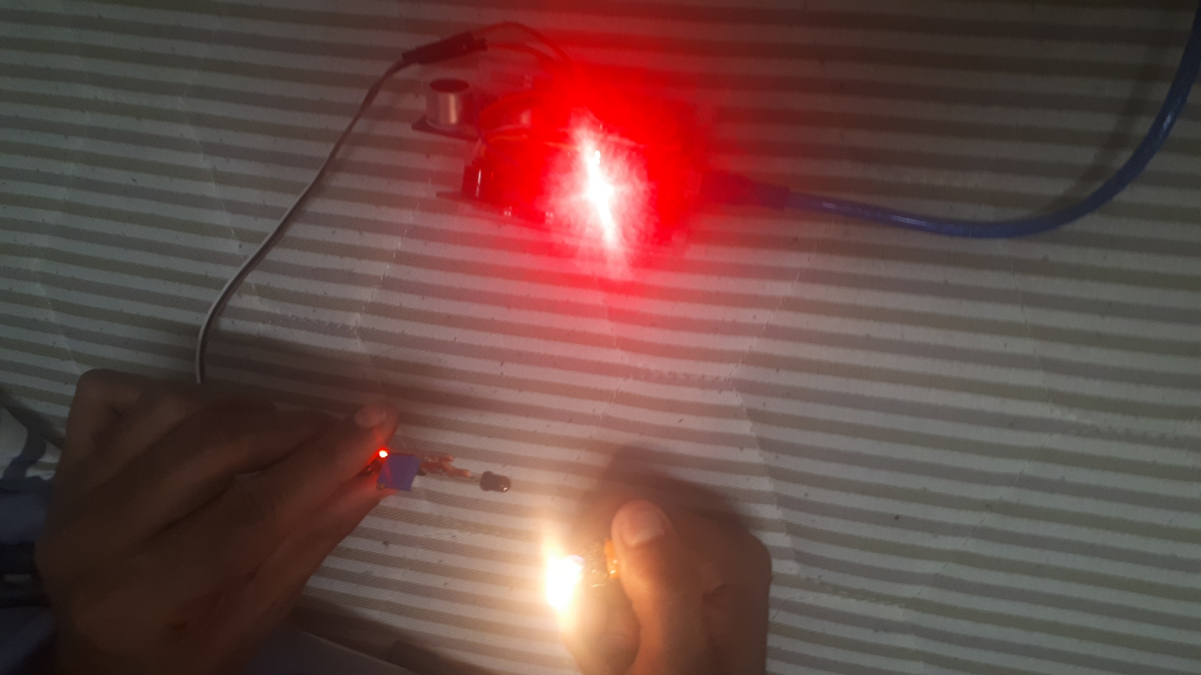
Implementation
Output

